Slide 1
Connecting Worlds: Revolutionizing Intranet Communication with Real-Time Java Chat Applet
Name: P. SaiRishika
Reg. No.: 192110339
Dept.: CSE

Slide 2
Intranet Chatting
Intranet chatting refers to the communication system within an organization's private network.
It allows users who are connected to the same intranet network to exchange messages, files, and information in real-time.
Intranet chatting typically occurs through dedicated software or applications designed for internal communication, providing a secure environment for employees to collaborate, share updates, and coordinate tasks within the organization.

Slide 3
Building a Java Swing for Intranet Chatting
Aim: Enhance internal communication and collaboration within the organization's intranet environment
Develop Java applet for Intranet Chatting system
Real-time communication within organization's intranet network
User-friendly interface for sending and receiving messages
Features: Private messaging, group chat, user status indicators
Secure login with user credentials
View list of online users

Slide 4
UI Overview for Intranet Chat System
Secure Login: Users can securely log in using their credentials, ensuring access only to authorized personnel.
Main Chat Interface: The main chat interface provides a clean and intuitive design for sending and receiving messages. It includes:
Message Input Field: A text input area for composing messages.
Message Display Area: Displays incoming and outgoing messages in a threaded conversation format.
User Status Indicators: Visual indicators displaying the online/offline status of users.
Private Messaging: Users can initiate private conversations with specific individuals for confidential communication.Group Chat: Facilitates communication among multiple users in a shared chat space, enabling collaboration among teams or departments.
Online User List: A sidebar or dropdown menu displays a list of users currently online, allowing easy selection for initiating chats.

Slide 5
Java Applet Implementation Insights
Graphical User Interface (GUI):
Utilizes Java's Swing library for creating a visually appealing and interactive interface.
Implements various components such as text fields, buttons, panels, tables, and lists to facilitate user interaction.
Card Layout:
Utilizes Java's CardLayout manager to manage multiple panels within a single frame, allowing seamless navigation between different interface screens.
User Authentication:
Implements login functionality to authenticate users securely with their credentials.
Utilizes password masking for enhanced security.

Slide 6
User Registration:
Provides a sign-up option for new users to create accounts with unique usernames and passwords.
Message Exchange:
Enables real-time messaging between users within the intranet network.
Implements features for sending and receiving messages, including private messaging and group chat.
Status Display:
Displays user status indicating availability, busy, or away.
Utilizes a table to present user statuses in a structured format.
File I/O Operations:
Implements file input/output operations for storing and retrieving user credentials securely.
Utilizes BufferedReader and BufferedWriter classes for reading from and writing to a text file.

Slide 7
Working process of Intranet Chat Application implemented using Java Swing
Initialization: The 'IntranetChatApp' class extends 'JFrame' and implements 'ActionListener'. It initializes various Swing components like text fields, buttons, panels, etc., necessary for the user interface.
GUI Construction: The constructor 'IntranetChatApp()' sets up the GUI by creating panels for login, sign up, message display, user status, group chat, and online users. It also configures a 'CardLayout' for managing these panels.
User Interaction Handling: The 'actionPerformed()' method handles user interactions such as button clicks. Depending on the action performed, it switches between panels using the 'CardLayout'.

Slide 8
User Authentication: The 'checkCredentials()' method verifies user credentials by reading from a text file ('credentials.txt'). If the credentials match, the user is logged in; otherwise, an error message is displayed.
User Registration: The 'saveCredentials()' method allows users to register by writing their username and password to the 'credentials.txt' file.
Message Sending: The 'sendMessage()' method appends the user's message to the chat area and clears the message input field.
Main Method: The 'main()' method invokes the 'IntranetChatApp' constructor on the Event Dispatch Thread (EDT) to ensure proper initialization of the Swing components.

Slide 9
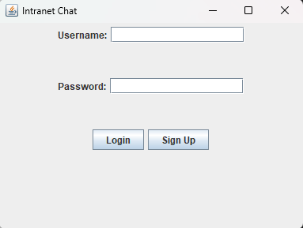
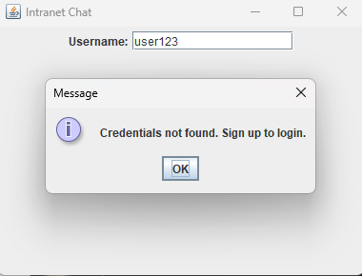
When the code is run, the user will first see a Login page where the user must enter their credentials.
If the entered credentials are not present in the code’s database, it then gives the user a pop-up message asking the user to sign up to login.

Slide 10
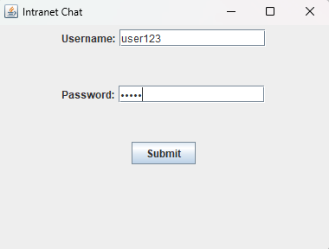
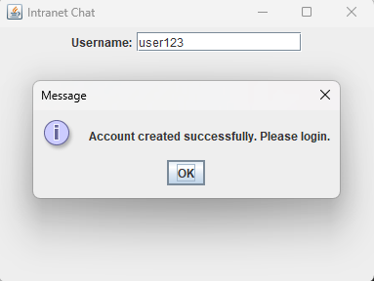
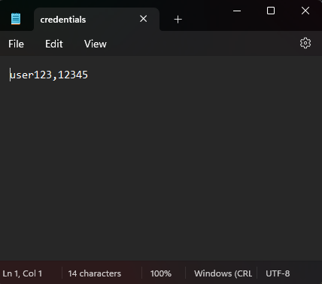
When the user clicks on the sign up button, the user will then be directed to a sign up page where the user must enter their credentials like username and password to register.
On clicking the submit button, the user’s credentials will be saved in the text document created by the code “credentials.txt”

Slide 11
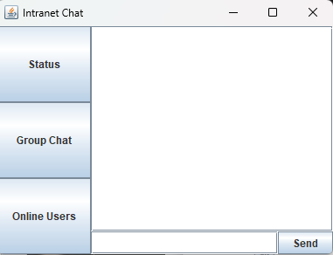
Now, when the user logins in with their credentials, the code will check for the details in the text file. If the particulars are available, it will login.
The user will be provided the home page which consists of a messaging box and three buttons “Status”, “Group Chat”, “Online Users”.

Slide 12
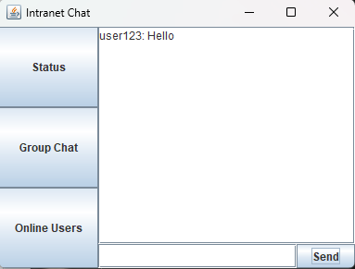
Upon clicking on each of the buttons, they open their respective panels.
The message can be typed in the message bar and the upon clicking the send button, the message will be sent.

Slide 13
Conclusion
In conclusion, our Intranet Chat Application, crafted with Java Swing, promises to revolutionize internal communication. With its intuitive interface and robust features, it fosters collaboration, enhances productivity, and brings teams closer together within the organization's intranet environment. Experience the power of seamless chatting and embark on a journey towards enhanced teamwork and connectivity.

Slide 14
Thank You

